Slide 1


Weather Forecasting Website
Welcome to our cutting-edge weather forecasting website. Our team has worked tirelessly to develop a comprehensive solution that provides accurate, up-to-the-minute weather data and insights to help you plan your day with confidence.
by Pulkit Bajaj

Slide 2
Introduction of Project and Team Members
Project Overview
Meet the Team
Shared Passion
Our weather forecasting website aims to revolutionize how people access and utilize weather information, making it easier to plan their daily activities and prepare for changing conditions.
Our talented team comprises experts in meteorology, data analysis, web development, and user experience design, all working in harmony to deliver an exceptional product.
We are driven by a shared passion for providing accurate and accessible weather information to our users, ultimately enhancing their ability to make informed decisions.

Slide 3

Problem Statement, Technical Details, Project Highlights, Bonus Features, Conclusion, References
1
Problem Statement
2
Technical Details
Existing weather websites often provide complex, overwhelming data that is difficult for users to interpret. We aim to simplify the user experience and deliver tailored weather information.
Our website leverages advanced weather modeling algorithms, real-time data sources, and responsive web design to provide a seamless user experience across devices.
3
Project Highlights
4
Bonus Features
Key features include personalized weather alerts, interactive visualizations, and location-based forecasting to help users plan their daily activities with confidence.
Upcoming updates will include extended forecasting, air quality monitoring, and a mobile app for weather-on-the-go, providing users with even more valuable weather insights.

Slide 4

Introduction
Welcome to our comprehensive weather forecasting website, designed to provide you with accurate, up-to-date weather information to help you plan your day and prepare for changing conditions.

Slide 5

Problem Statement and Solution
1
Problem
Existing weather websites often present users with overwhelming, complex data that is difficult to interpret and use effectively.
2
Solution
Our weather forecasting website simplifies the user experience by providing tailored, easy-to-understand weather information and insights.
3
Outcome
Users can now make informed decisions about their daily activities and prepare for changing weather conditions with confidence.

Slide 6

Technologies Used (HTML, CSS, JavaScript)
HTML
CSS
We use HTML to structure the content and layout of our weather forecasting website, ensuring a clean and accessible user experience.
CSS is used to style the website, creating a visually appealing and responsive design that adapts to various devices and screen sizes.
JavaScript
JavaScript powers the interactive features of our website, including real-time weather data updates, personalized alerts, and dynamic visualizations.

Slide 7
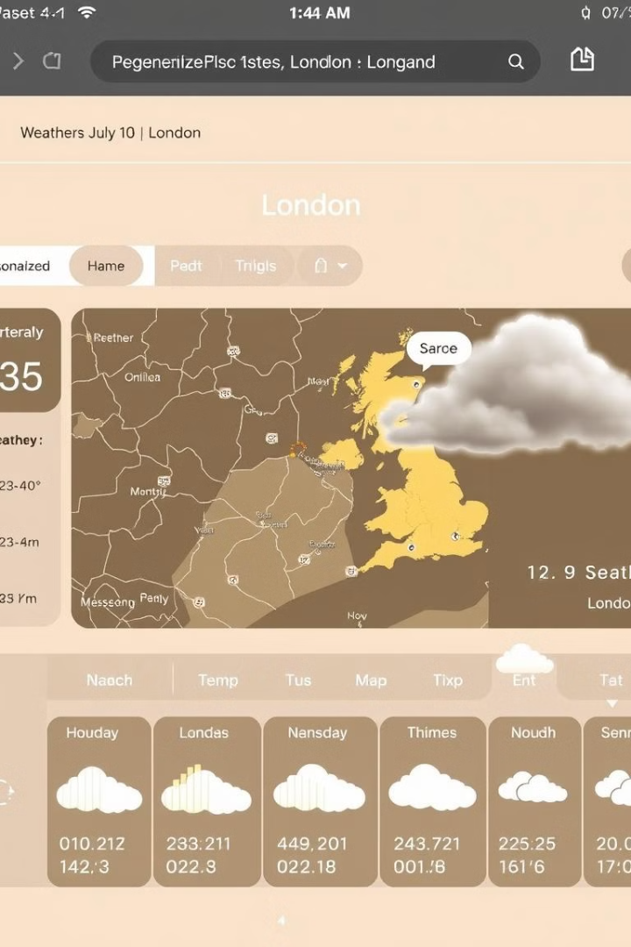



Key Features
Location-based Forecasting
Our website provides tailored weather information based on the user's location, allowing for more accurate and relevant predictions.
Personalized Alerts
Users can set up custom weather alerts to stay informed about changes in temperature, precipitation, or severe weather conditions.
Interactive Visualizations
Our website features dynamic charts, graphs, and maps to help users better understand and interpret weather data and trends.

Slide 8
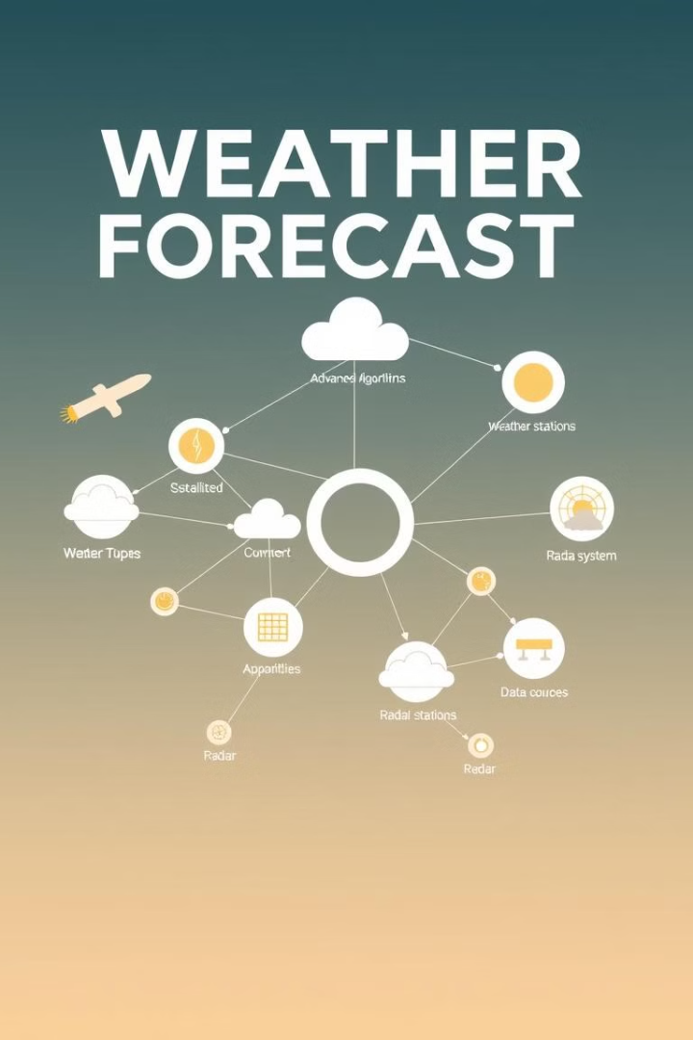



Key Innovation
Advanced Algorithms
Our weather forecasting website utilizes cutting-edge machine learning algorithms to analyze vast amounts of weather data and provide more accurate and reliable predictions.
Multi-source Data
We integrate data from various real-time sources, including government weather agencies, satellite imagery, and crowd-sourced information, to deliver a comprehensive and up-to-date weather overview.
Seamless Integration
The seamless integration of these advanced technologies and data sources allows our website to provide users with a truly innovative and sophisticated weather forecasting experience.

Slide 9

Summary
1
Empowering Users
2
Innovative Approach
Our weather forecasting website empowers users to make informed decisions and better prepare for changing weather conditions.
By leveraging cutting-edge technologies and data sources, we deliver a unique and comprehensive weather forecasting solution.
3
Ongoing Improvements
We are committed to continuously enhancing our website, adding new features and capabilities to better serve our users.

Slide 10

Thank You
Thank you for your interest in our weather forecasting website. We are excited to provide you with a valuable and innovative solution that will help you plan your day and stay one step ahead of the weather.

